Slide 1
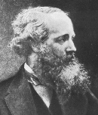
Electromagnetism

Slide 2
Electromagnetic Waves
Let’s assume that we have electric fields without a charged body. Can it happen?
  1860 – Years after Faraday and Oersted made their discoveries – James Maxwell hypothesized that electric fields changing in time would create magnetic fields and vice-versa.
  Maxwell further predicted that either accelerating charges (changing current) or changing magnetic fields would produce electric and magnetic fields that would move through space (Electromagnetic Wave).

Slide 3
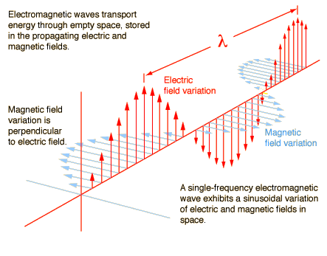
Electromagnetic Waves (cont.)
Electromagnetic Wave
www.hyperphysics.com

Slide 4
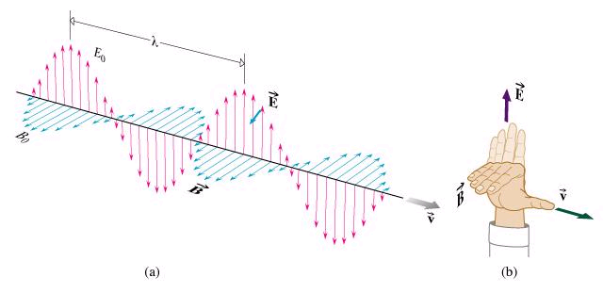
Characteristics of Electromagnetic Waves
They are transverse waves.
When the electric field is at a maximum, the magnetic field is also at a maximum.
Use RHR to determine the direction of B relative E.
The electric and magnetic fields are always perpendicular to one another.
They are sinusoidal.
EM Radiation travels at the speed of light in a vacuum.
Normandale Community College

Slide 5
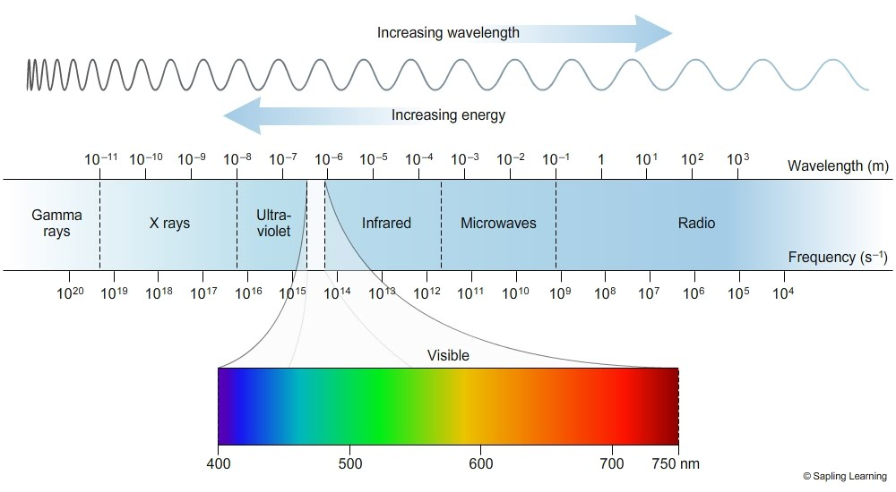
Electromagnetic Spectrum

Slide 6
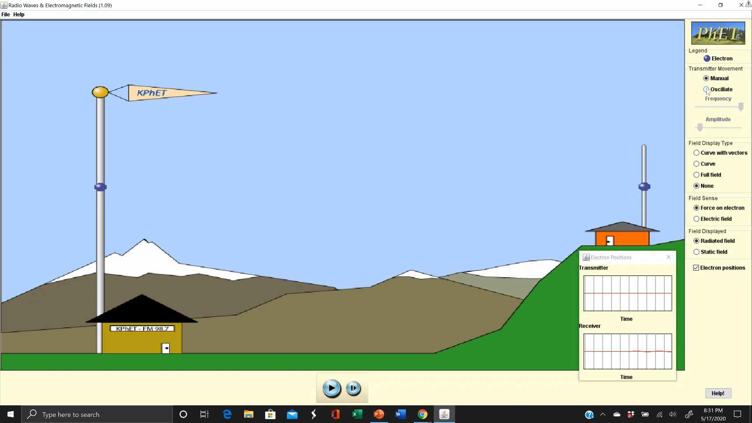
Transmitting and Receiving a Radio Wave
AM = Amplitude Modulation where information is imbedded into the wave by changing its amplitude or power.
FM = Frequency Modulation where information is imbedded into the wave by changing its frequency.

Slide 7

Determining the Speed of Light
$$c=\text{299}\text{,}\text{792}\text{,}\text{458 }\text{m}\text{/}\text{s}$$
$$c=\text{186,282} \text{miles}\text{/}\text{s}$$

Slide 8
The Speed of Light
Before the 17th Century, most people believed that light traveled instantaneously.
Galileo first hypothesized that light has a finite speed.
Ole Roemer made 70 careful measurements of the lunar eclipse of Io (a moon of Jupiter) from 1668 – 1674.
  When the Earth was at its furthest distance from Jupiter, Roemer determined that the lunar eclipse took 22 minutes longer than when the Earth was closest Jupiter.
  He calculated the speed of light to be 1.36 x 10⁵ miles/second.

Slide 9

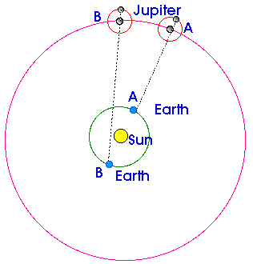
Ole Roemer’s Experiment
Earth
IO
Roemer took
70 Measurements
over 6 years
Jupiter

Slide 10
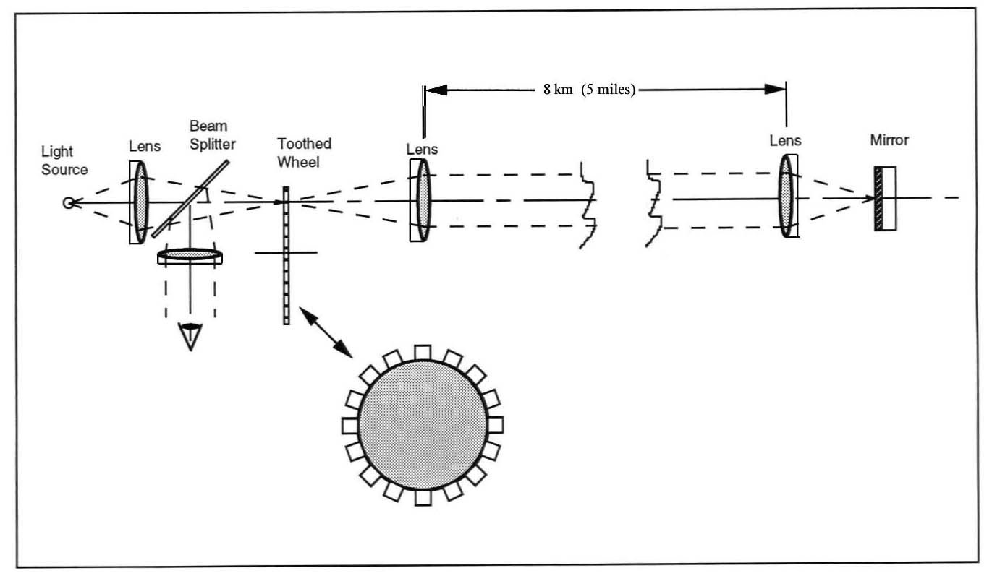
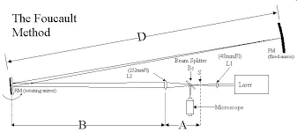
Fizeau and Foucault
1849: Fizeau created an elaborate device using a combination of mirrors lenses and a rotating wheel with slits.
  c = 196,000 miles/s (315,000 km/s)
1862: Focault took a slightly different approach that included a set of rotating mirrors.
  c = 185,000 miles/s (298,000 km/s)
The Fizeau Method

Slide 11

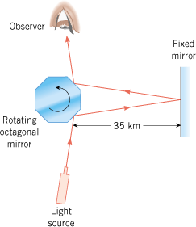
The Michelson Experiment
1926: Albert Michelson measured the amount of time that it took light to make a round trip between two mountains in California that were 21.7 miles (34.9 km) apart using the Foucault method.
Michelson’s value for the speed of light was calculated as 186,300 miles/second (299,798 km/s).
Mount Wilson Observatory
San Antonio Mountain

Slide 12
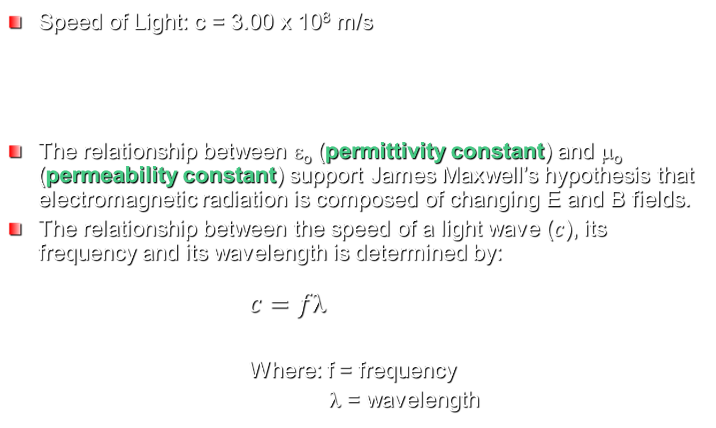
Speed of Light
Speed of Light: c = 3.00 x 10⁸ m/s
The relationship between ε_{o} (permittivity constant) and μ_{o} (permeability constant) support James Maxwell’s hypothesis that electromagnetic radiation is composed of changing E and B fields.
The relationship between the speed of a light wave ($c$), its frequency and its wavelength is determined by:
$c=f$
Where: f = frequency
λ = wavelength

Slide 13
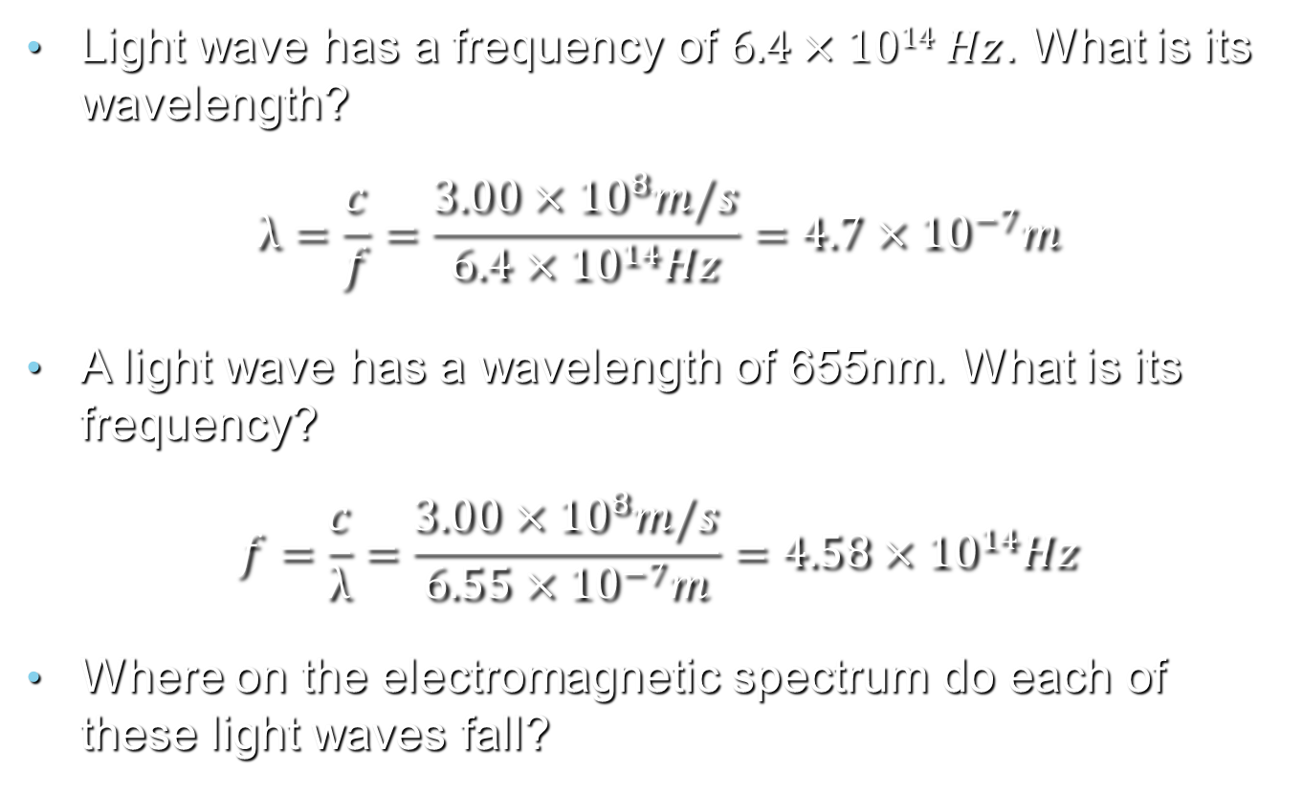
Example
Light wave has a frequency of $6.4×1014 Hz$. What is its wavelength?
$$λ=\frac{c}{f}=\frac{3.00×{10}^{8}m/s}{6.4×{10}^{14}Hz}=4.7×{10}^{−7}m$$
A light wave has a wavelength of 655nm. What is its frequency?
$$f=\frac{c}{λ}=\frac{3.00×{10}^{8}m/s}{6.55×{10}^{−7}m}=4.58×{10}^{14}Hz$$
Where on the electromagnetic spectrum do each of these light waves fall?

Slide 14
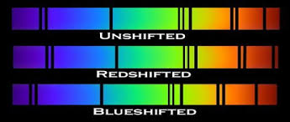
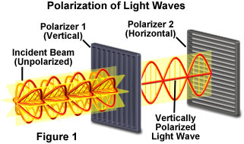
The Doppler Effect and Polarization
www.mic-d.com

Slide 15

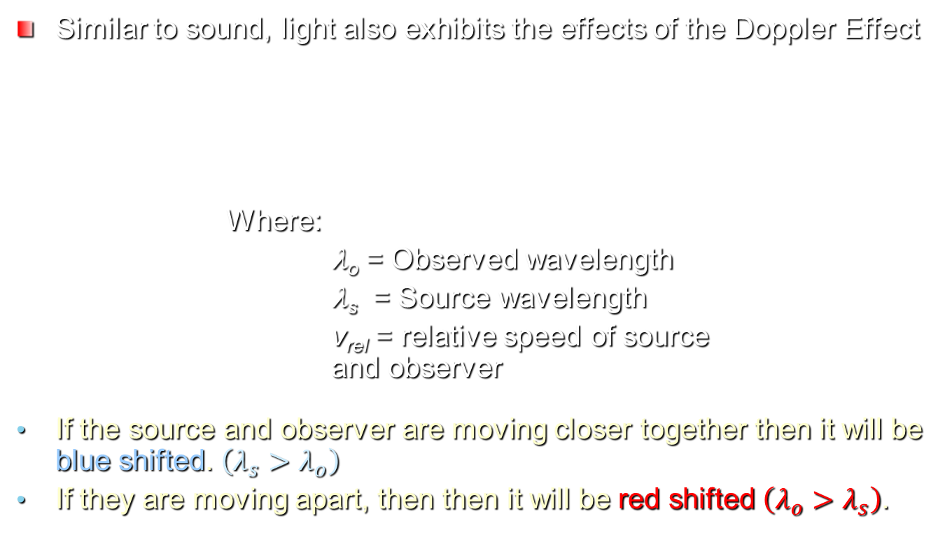

The Doppler Effect
Similar to sound, light also exhibits the effects of the Doppler Effect
Where:
λ_{o} = Observed wavelength
λ_{s} = Source wavelength
v_{rel} = relative speed of source and observer
If the source and observer are moving closer together then it will be blue shifted. $\left(λ_{s}>λ_{o}\right)$
If they are moving apart, then then it will be red shifted $\left(λ_{o}>λ_{s}\right)$.
$$v_{rel}=c\left(1−\frac{λ_{s}}{λ_{o}}\right)$$
$$v_{rel}=c\left(\frac{λ_{s}}{λ_{o}}−1\right)$$
Redshift
Blueshift

Slide 16
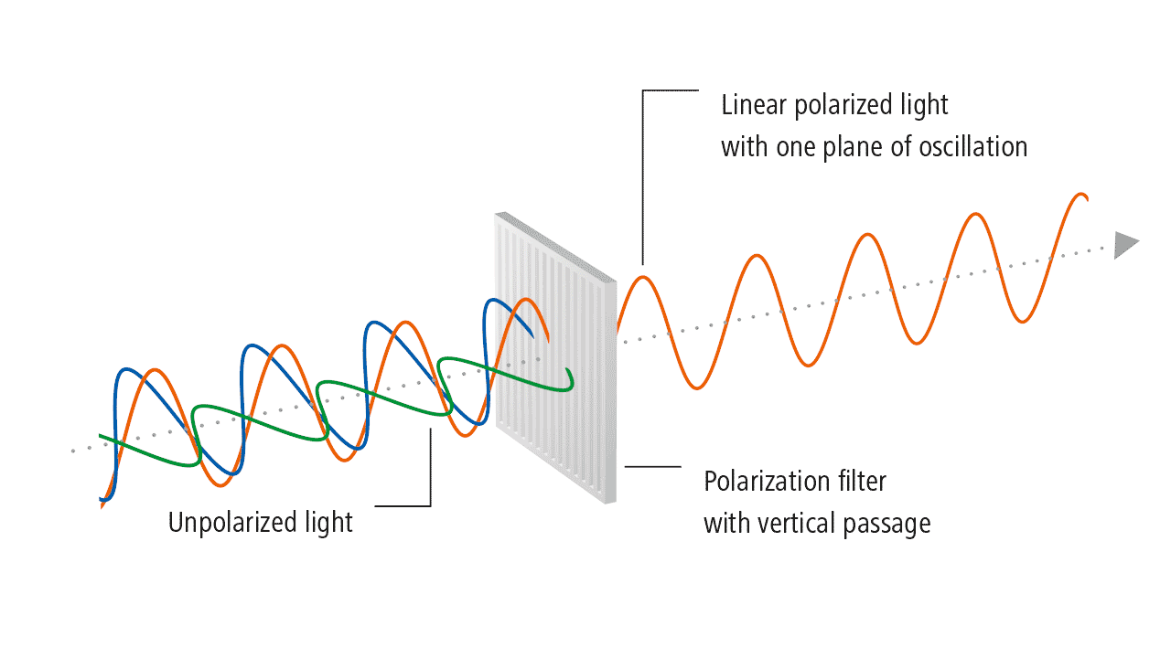
Light Polarization
Light is generally emitted from its source with the electric field oscillating in various directions.
Polarizers eliminate the electric field oscillations in all directions but one.
Polarized light has only half the energy of the incident beam.
Note: polarizers can
only work on transverse
waves such as light.
They don’t work on
longitudinal waves such
as sound waves.

Slide 17
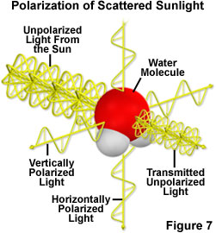
Light Polarization in Nature
  Light incident upon the water molecules in the atmosphere will excite electrons in the atoms to oscillate in a direction 90º from the incident beam.
  Oscillating electrons act as antennas that re-emit the light that is now polarized.
  Over 50% of the polarized light that reaches the ground is polarized horizontally.
    Why should this matter?
www.mic-d.com

Slide 18
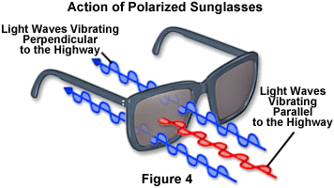
Light Polarization in Nature
Some of the light incident upon horizontal surfaces such as the highway or the surface of a body of water will be reflected, producing glare.
If the electric field of the incident light vibrates parallel to the surface, it will be more prone to being reflected.
Hence, the reflected light is largely polarized.

Slide 19
Key Ideas
Electromagnetic waves consist of electric and magnetic fields oscillating together.
Electromagnetic waves are transverse waves.
The electromagnetic spectrum consists of radio waves (long wavelength) to gamma waves (short wavelength).

Slide 20
Key Ideas
Doppler Effect: When two objects are moving further apart they are called red-shifted while they are considered blue-shifted if moving closer together.
Polarization: The process by which the electric field component of EM radiation is limited to only one direction.

Slide 21
Last Time
Electromagnetic induction: The process by which current is generated by moving a conductor through a magnetic field or a magnetic field through a conductor.
Electromotive Force: When a wire moves through a magnetic field, a force is exerted on these charges causing them to flow as current.
Magnetic Flux: The strength of a magnetic field is determined by the amount of magnetic field lines crossing perpendicular to a surface.
Electric Generators: Convert mechanical power into electrical power.
Lenz’s Law: The induced EMF resulting from a changing magnetic flux has a polarity that leads to an induced current whose direction is such that the induced magnetic field opposes the original flux change.

Slide 22
What You Will Learn About
How Electric and Magnetic Fields Interact through electromagnetic radiation
The Electromagnetic Spectrum
The Doppler Effect
Polarization

Slide 23


Transmitting Radio Waves
Produced by alternating the potential back and forth on an antenna.
AM = Amplitude Modulation where information is imbedded into the wave by changing its amplitude or power.
FM = Frequency Modulation where information is imbedded into the wave by changing its frequency.

Slide 24
Receiving Radio Waves
Process of receiving a radio signal is reverse that of transmitting.
The electric field will cause electrons in the antenna to oscillate back and forth in the conductor, which in this case is an antenna.
This changing current can be electronically manipulated to convert it into sound at your speakers.
Note: Antenna needs to be oriented in the same direction (parallel) to that producing the wave in order to optimally receive the signal, i.e. if one is vertical, then so should the other.

